Slide 1

Unit 3 Strings
By. Dr. Amit.

Slide 2
Searching Strings
The String class provides two methods that allow you to search a string for a specified character or substring:
• indexOf( ) Searches for the first occurrence of a character or substring.
• lastIndexOf( ) Searches for the last occurrence of a character or substring.
→ These two methods are overloaded in several different ways. In all cases, the methods return the index at which the character or substring was found, or –1 on failure.
To search for the first occurrence of a character, use
int indexOf(char ch)
To search for the last occurrence of a character, use
int lastIndexOf(char ch)
Here, ch is the character being sought.
To search for the first or last occurrence of a substring, use
int indexOf(String str)
int lastIndexOf(String str)

Slide 3
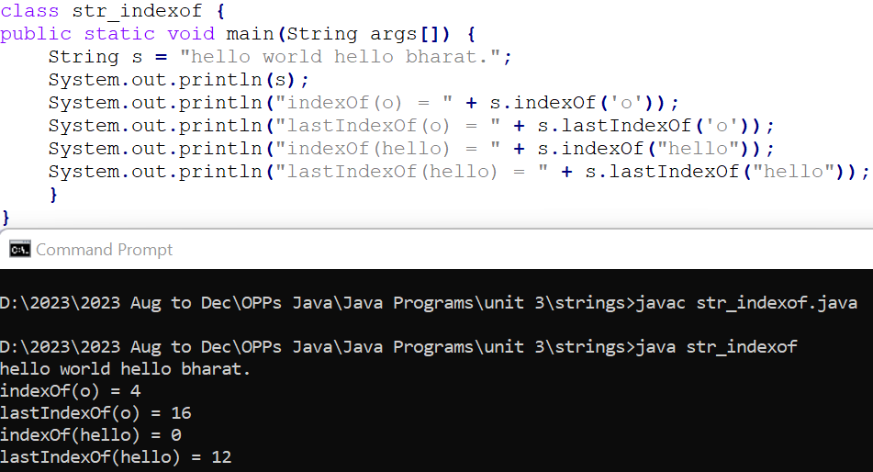
Example

Slide 4
Searching Strings
Here, str specifies the substring. You can specify a starting point for the search using these forms:
int indexOf(char ch, int startIndex)
int lastIndexOf(char ch, int startIndex)
int indexOf(String str, int startIndex)
int lastIndexOf(String str, int startIndex)
Here, startIndex specifies the index at which point the search begins.
For indexOf( ), the search runs from startIndex to the end of the string.
For lastIndexOf( ), the search runs from startIndex to zero.

Slide 5
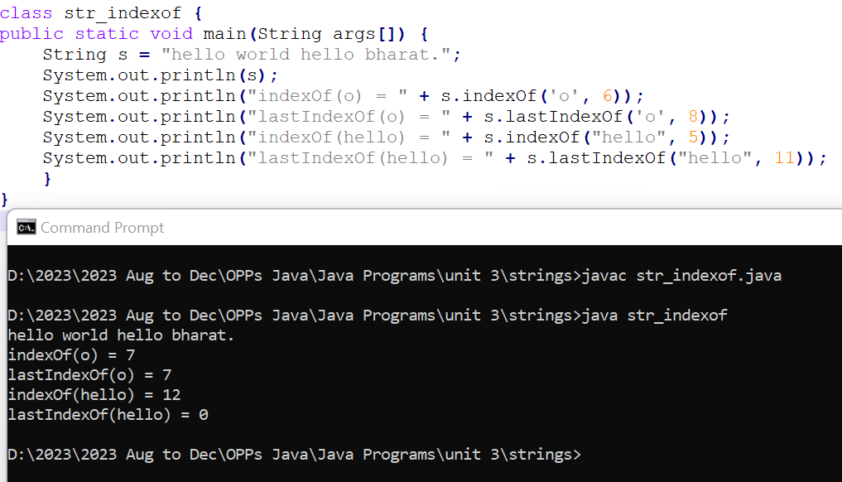
Example

Slide 6
Modifying a String: concat( )
You can concatenate two strings using concat( ), shown here:
String concat(String str)
This method creates a new object that contains the invoking string with the contents of str appended to the end. concat( ) performs the same function as +. For example,
String s1 = "one";
String s2 = s1.concat("two");
puts the string "onetwo" into s2. It generates the same result as the following sequence:
String s1 = "one";
String s2 = s1 + "two";

Slide 7
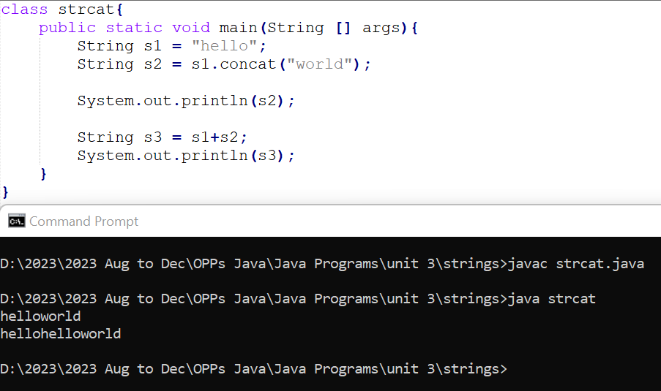
Example

Slide 8
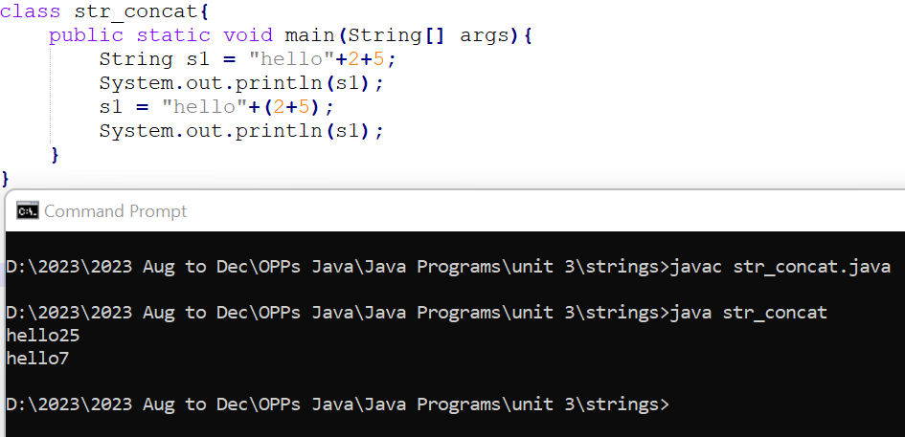
String concatenation with other datatypes

Slide 9
Modifying a String: replace( )
The replace( ) method has two forms. The first replaces all occurrences of one character in the invoking string with another character. It has the following general form:
String replace(char original, char replacement)
Here, original specifies the character to be replaced by the character specified by replacement. The resulting string is returned. For example,
The second form of replace( ) replaces one character sequence with another. It has this general form:
String replace(CharSequence original, CharSequence replacement)

Slide 10
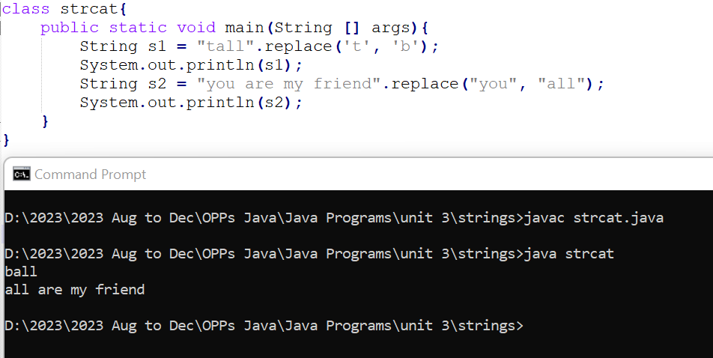
Example

Slide 11
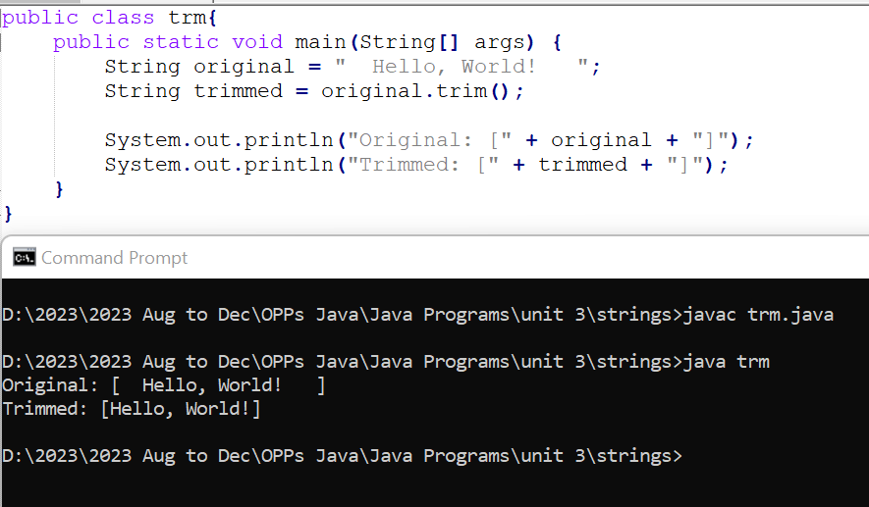
Modifying a String: trim( )
The trim() method returns a copy of the invoking string from which any leading and trailing whitespace has been removed. It has this general form:
String trim()

Slide 12
Changing the Case of Characters Within a String
The method toLowerCase( ) converts all the characters in a string from uppercase to lowercase.
The toUpperCase( ) method converts all the characters in a string from lowercase to uppercase. Nonalphabetical characters, such as digits, are unaffected. Here are the simplest forms of these methods:
String toLowerCase( )
String toUpperCase( )
→ Both methods return a String object that contains the uppercase or lowercase equivalent of the invoking String. The default locale governs the conversion in both cases.

Slide 13
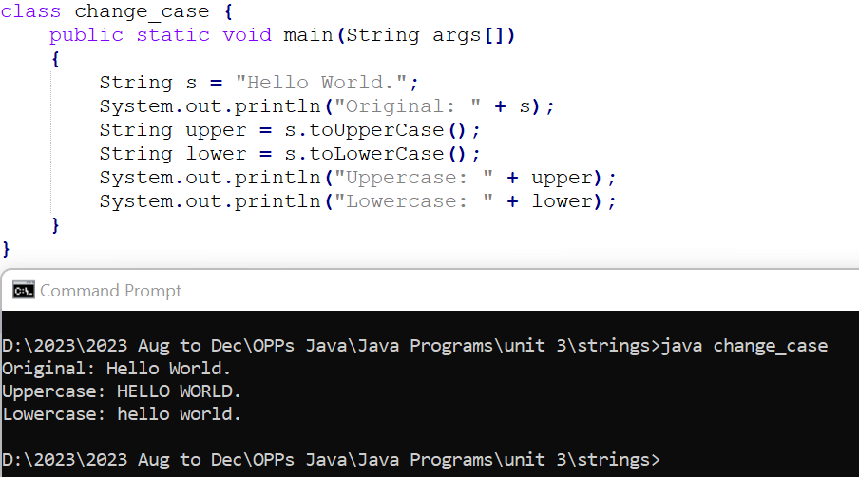
Changing the Case of Characters Within a String

Slide 14
Joining Strings
JDK 8 adds a new method to String called join( ).
It is used to concatenate two or more strings, separating each string with a delimiter, such as a space or a comma.
It has two forms. Its first is shown here:
static String join(CharSequence delim, CharSequence . . . strs)
→ Here, delim specifies the delimiter used to separate the character sequences specified by strs. Because String implements the CharSequence interface, strs can be a list of strings.

Slide 15
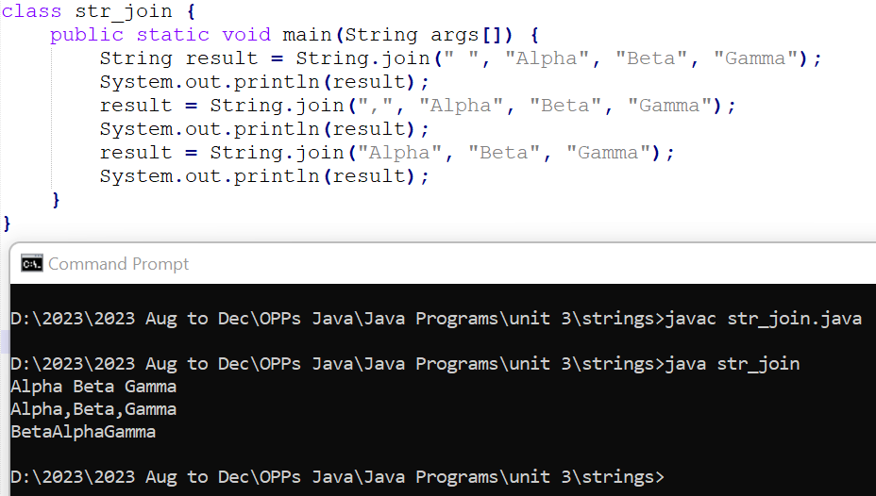
Joining Strings

Slide 16
Character Extraction
The String class provides a number of ways in which characters can be extracted from a String object.
Although the characters that comprise a string within a String object cannot be indexed as if they were a character array, many of the String methods employ an index (or offset) into the string for their operation.
Like arrays, the string indexes begin at zero.

Slide 17
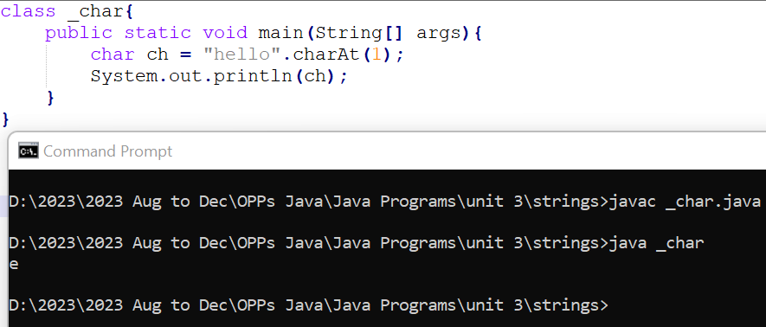
Character Extraction: charAt( )
To extract a single character from a String, you can refer directly to an individual character via the charAt( ) method. It has this general form:
char charAt(int where)
→ Here, where is the index of the character that you want to obtain. The value of where must be nonnegative and specify a location within the string. charAt( ) returns the character at the specified location. For example,

Slide 18
Character Extraction: getChars( )
Method in Java use to extract a range of characters from a String and store them in a character array (char[]).
void getChars(int srcBegin, int srcEnd, char[] dst, int dstBegin)
srcBegin: The starting index (inclusive) in the source string from which characters should be copied.
srcEnd: The ending index (exclusive) in the source string until which characters should be copied.
dst: The destination character array where the extracted characters will be placed.
dstBegin: The starting index in the destination character array where the characters will be placed.

Slide 19
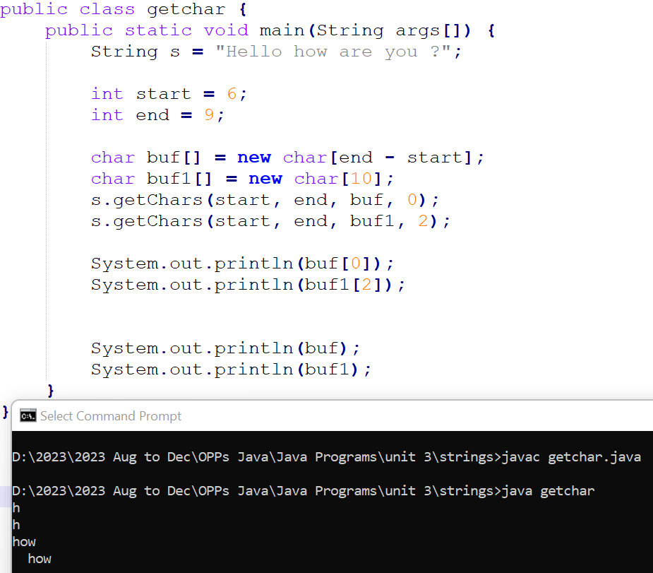

Slide 20
Character Extraction: toCharArray( )
If you want to convert all the characters in a String object into a character array, the easiest way is to call toCharArray( ).
It returns an array of characters for the entire string. It has this general form:
char[ ] toCharArray( )
This function is provided as a convenience, since it is possible to use getChars( ) to achieve the same result.

Slide 21
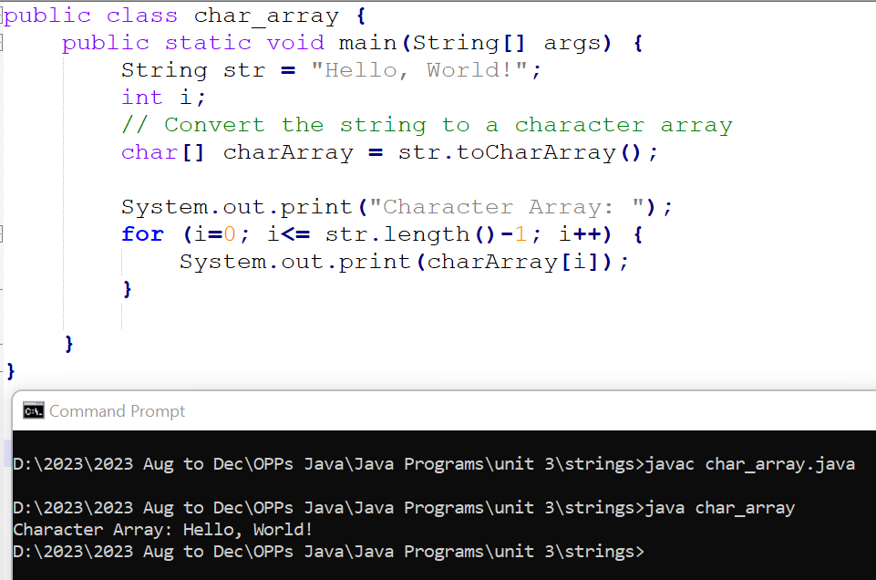
Example

Slide 22
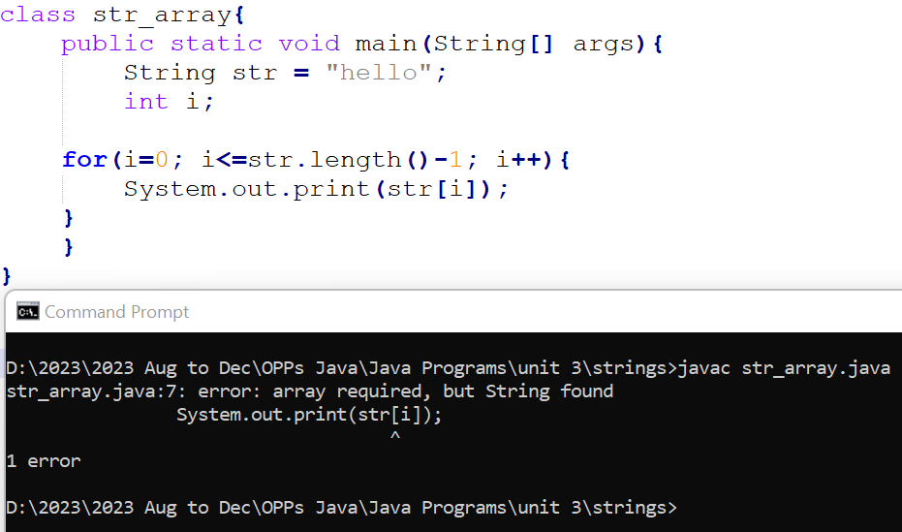
Array of characters are not String object.

Slide 23
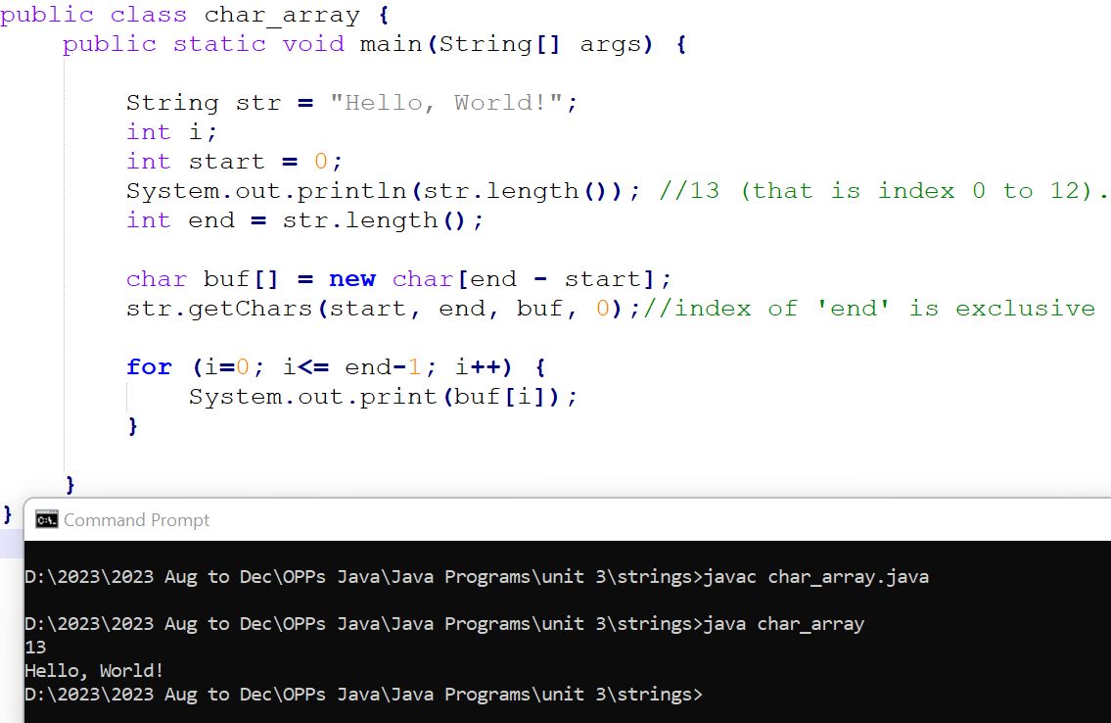
String to character array using getChars() function

Slide 24
String Comparison: equals( ) and equalsIgnoreCase( )
To compare two strings for equality, use equals( ). It has this general form:
boolean equals(String str)
→ Here, str is the String object being compared with the invoking String object. It returns true if the strings contain the same characters in the same order, and false otherwise. The comparison is case-sensitive.
To perform a comparison that ignores case differences, call equalsIgnoreCase( ). When it compares two strings, it considers A-Z to be the same as a-z. It has this general form:
boolean equalsIgnoreCase(String str)
→ Here, str is the String object being compared with the invoking String object. It, too, returns true if the strings contain the same characters in the same order, and false otherwise.

Slide 25
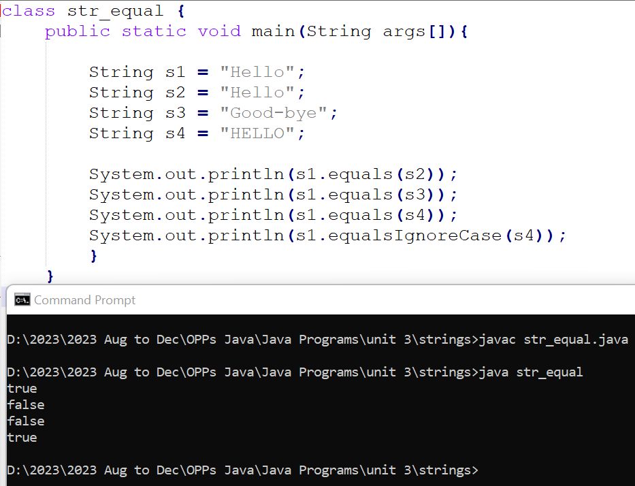
String Comparison: equals( ) and equalsIgnoreCase( )

Slide 26
String Comparison: regionMatches( )
The regionMatches( ) method compares a specific region inside a string with another specific region in another string.
boolean regionMatches(int startIndex, String str2, int str2StartIndex, int numChars)

Slide 27
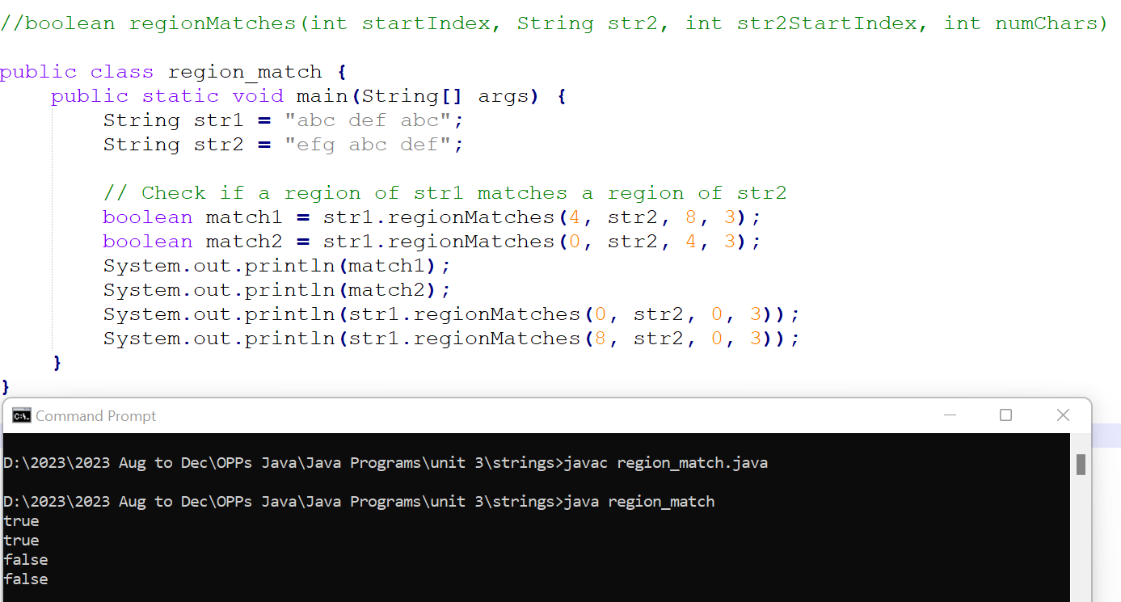

Slide 28
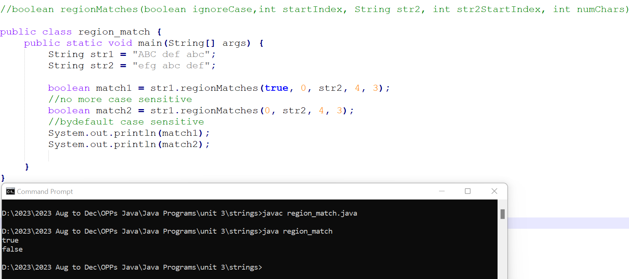
There is an overloaded form that allows you to ignore case in such comparisons. Here are the general forms for these two methods:
boolean regionMatches(boolean ignoreCase,int startIndex, String str2, int str2StartIndex, int numChars)

Slide 29
String Comparison: startsWith( ) and endsWith( )
String defines two methods that are, more or less, specialized forms of regionMatches( ).
The startsWith( ) method determines whether a given String begins with a specified string. Conversely, endsWith( ) determines whether the String in question ends with a specified string. They have the following general forms:
boolean startsWith(String str)
boolean endsWith(String str)

Slide 30
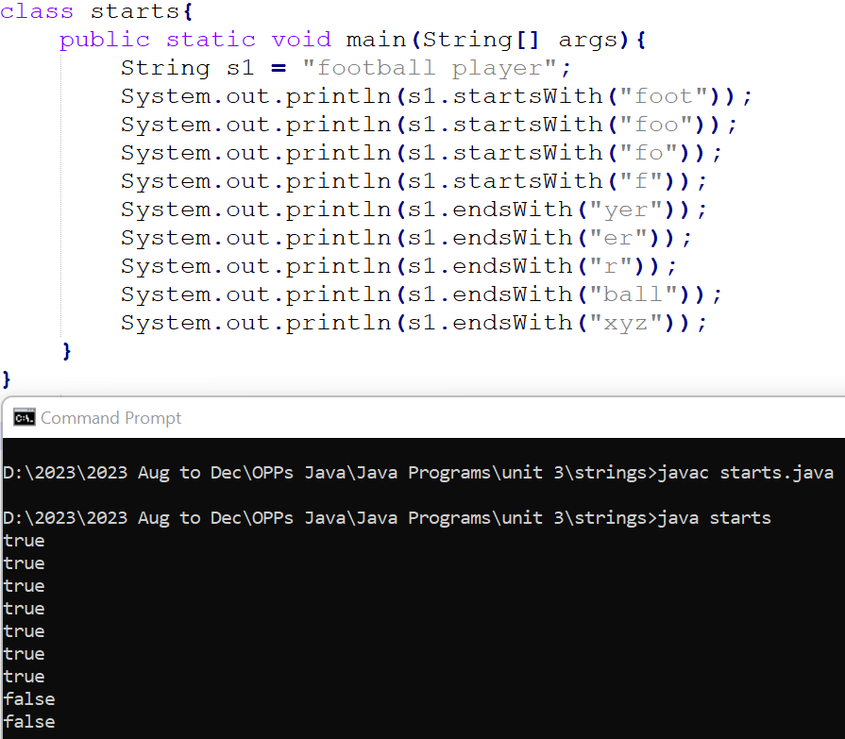

Slide 31
A second form of startsWith( ), shown here, lets you specify a starting point:
boolean startsWith(String str, int startIndex)
Here, startIndex specifies the index into the invoking string at which point the search will begin.

Slide 32
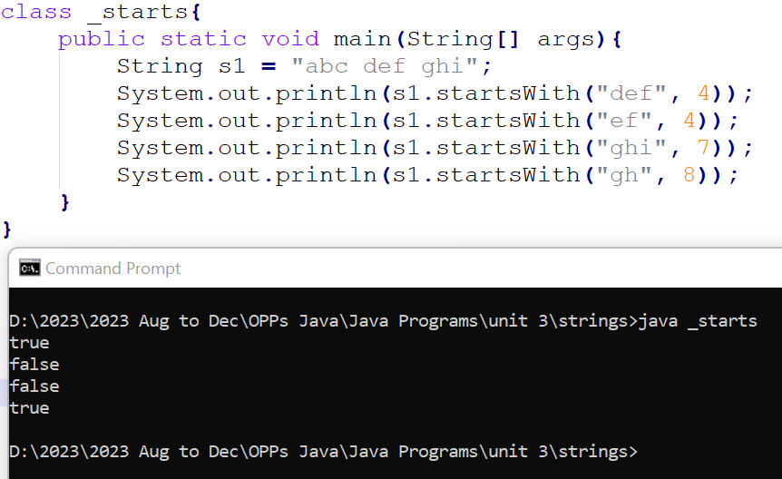

Slide 33
The String Constructors
1. The String class supports several constructors. To create an empty String, call the default constructor. For example,
String s = new String();
2. To create a String initialized by an array of characters, use the constructor shown here:
String(char chars[ ])
3. You can specify a subrange of a character array as an initializer using the following constructor:
String(char chars[ ], int startIndex, int numChars)
Here, startIndex specifies the index at which the subrange begins, and numChars specifies the number of characters to use.

Slide 34
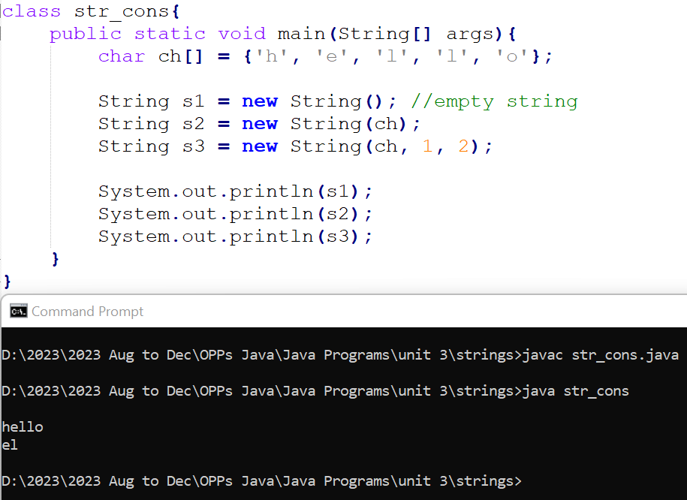

Slide 35
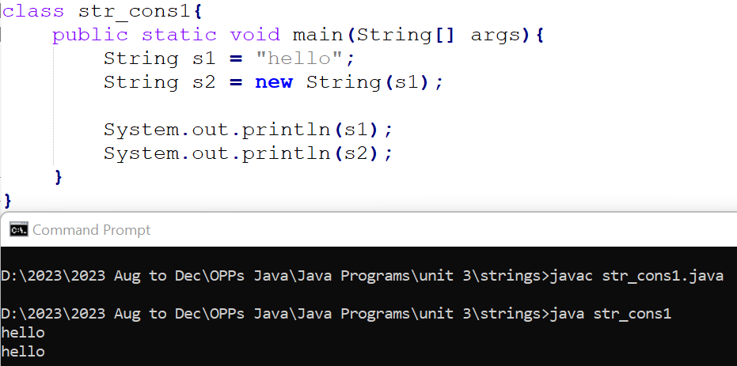
The String Constructors
4. You can construct a String object that contains the same character sequence as another String object using this constructor:
String(String strObj)
Here, strObj is a String object. Consider this example:

Slide 36
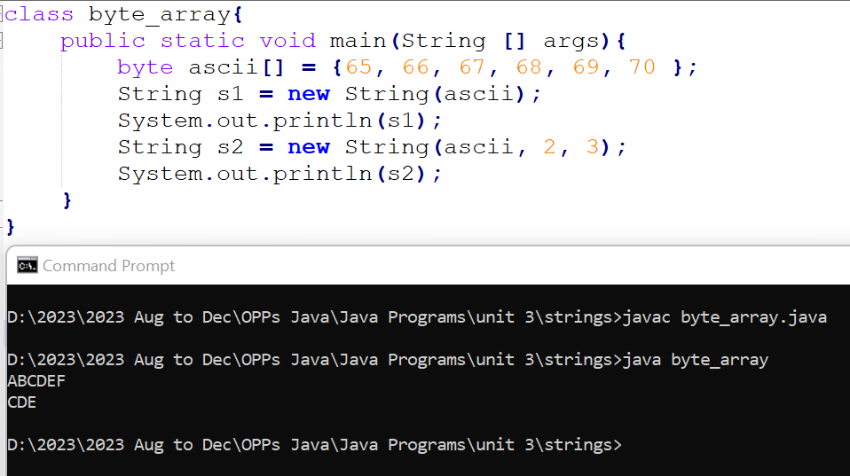
The String Constructors
5. String class provides constructors that initialize a string when given a byte array. Two forms are shown here:
String(byte chrs[])
String(byte chrs[], int startIndex, int numChars)
Here, chrs specifies the array of bytes. The second form allows you to specify a subrange. In each of these constructors, the byte-to-character conversion is done by using the default character encoding of the platform.

Slide 37
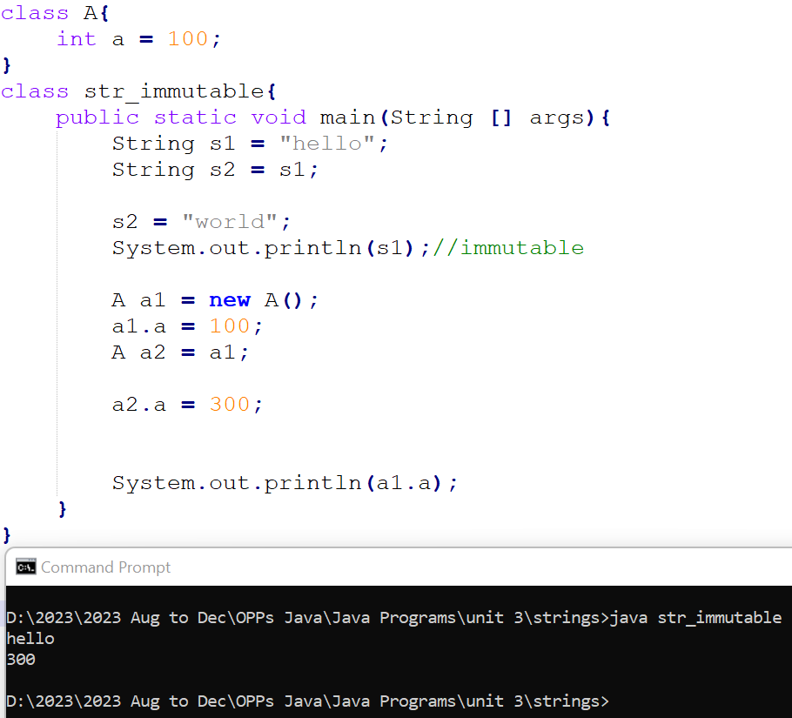
String created using an object of class String are immutable.
It create a another String object when we try to modify the existing string.

Slide 38
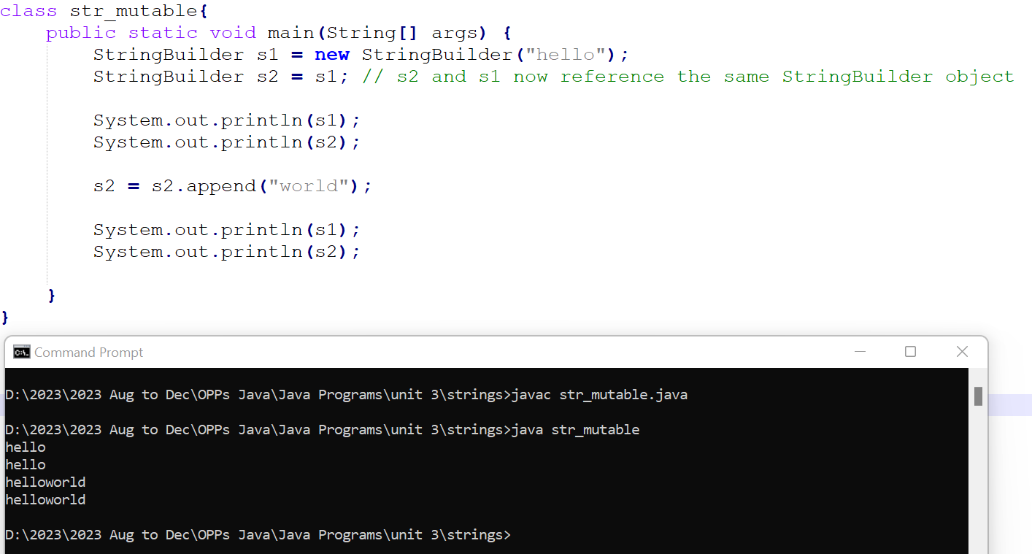
Java provides two options: StringBuffer and StringBuilder to create modifiable strings.

Slide 39
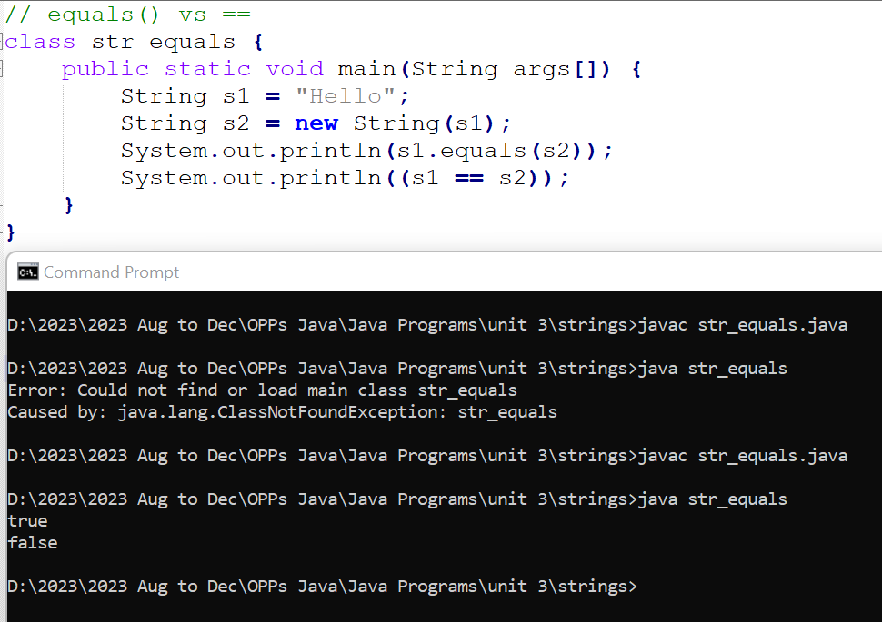
String Comparison: equals( ) Versus ==
It is important to understand that the equals( ) method and the == operator perform two different operations.
As just explained, the equals( ) method compares the characters inside a String object.
The == operator compares two object references to see whether they refer to the same instance.

Slide 40
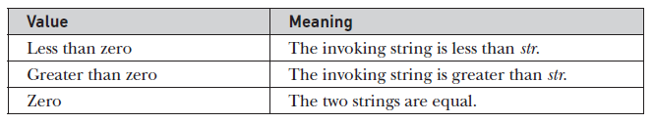
String Comparison: compareTo( )
Often, it is not enough to simply know whether two strings are identical.
For sorting applications, you need to know which is less than, equal to, or greater than the next.
A string is less than another if it comes before the other in dictionary order. A string is greater than another if it comes after the other in dictionary order.
The method compareTo( ) serves this purpose. It is specified by the Comparable<T> interface, which String implements. It has this general form:
int compareTo(String str)
Here, str is the String being compared with the invoking String. The result of the comparison is returned and is interpreted as shown here:

Slide 41
String Comparison: compareTo( )
// A bubble sort for Strings.
class SortString {
static String arr[] = {
"Now", "is", "the", "time", "for", "all", "good", "men", "to", "come", "to", "the", "aid", "of", "their", "country“ };
public static void main(String args[]) {
for(int j = 0; j < arr.length; j++) {
for(int i = j + 1; i < arr.length; i++) {
if(arr[i].compareTo(arr[j]) < 0) {
String t = arr[j];
arr[j] = arr[i];
arr[i] = t;
}
}
System.out.println(arr[j]);
}
}
}
The output of this program is the list of words:
Now
aid
all
come
country
for
good
is
men
of
the
the
their
time
to
to

Slide 42
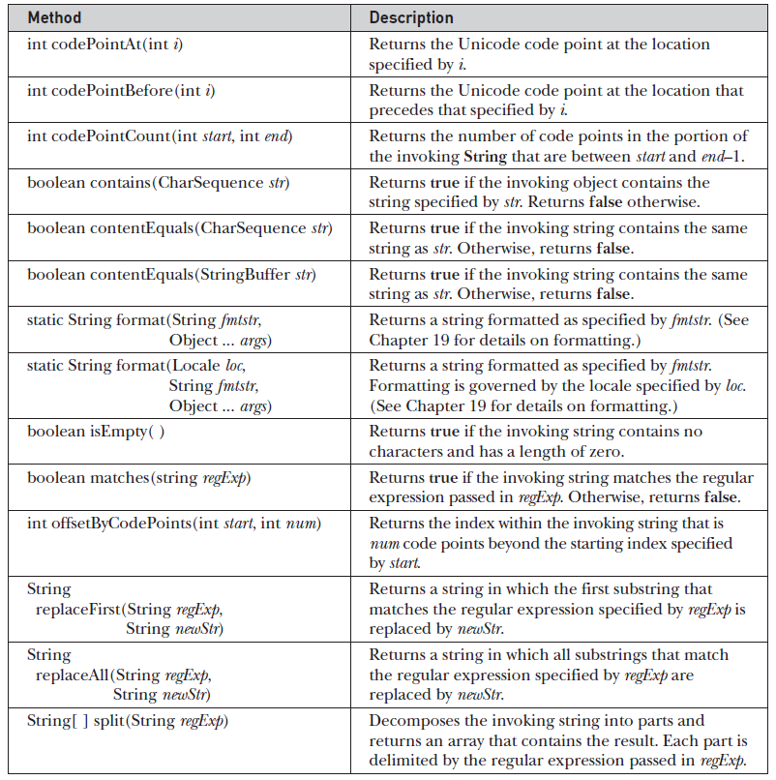
Additional String Methods

Slide 43
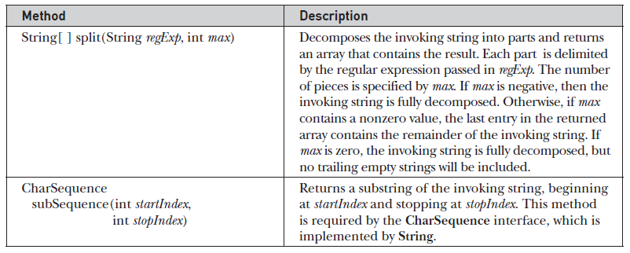
Additional String Methods

